Slide 1
Practicum Kick-off
Using Predictive Analytics and AI to Tackle the Opioid Epidemic
October 02, 2019

Slide 2





Agenda
Introductions
Project Background
Practicum Project Expectations
Logistics
Questions

Slide 3
The opioid epidemic impacts U.S. public health and creates high health care costs
Project Background
The direct cost of healthcare, treatment, and law enforcement related to opioid abuse is ~$37 billion, and the indirect cost of lost productivity from abuse, unemployment, incarceration, and death is ~$42 billion. Private and public health care payers spend ~$72.5 billion annually on medical costs associated with opioid addiction.
Prescribing Practices | Population at Risk | Opioid Use Disorder Treatment
How can we treat chronic pain? | Who is at risk of opioid abuse? | How can we manage abuse, misuse, and diversion?
100M people suffer from chronic pain^{1.} 61.8M people in America (~19% of the population) received 1 or more opioid prescriptions in 2016². | In 2016, the amount of opioids prescribed was enough for every American to be medicated around the clock for 3 weeks³. 11.5M people misused prescription opioids in 2016⁴. | In 2016, 116 people died every day from opioid-related drug overdoses⁵. 170k people used heroin for the first time in 2016.⁴ Approximately ~75% reported abusing prescription opioids before⁶.
Sources:
(1) Institute of Medicine Report from the Committee on Advancing Pain Research, Care, and Education: Relieving Pain in America, A Blueprint for Transforming Prevention, Care, Education, and Research. The National Academies Press, 2011
(2) QuintilesIMS® Transactional Data Warehouse accessed in https://www.cdc.gov/drugoverdose/pdf/pubs/2017-cdc-drug-surveillance-report.pdf
(3) CDC Vital Signs July 2017 and CDC Surveillance Report August 2017
(4) 2016 National Survey on Drug Use and Health; Mortality in the United States
(5) Department of Health and Human Services
(6) Cicero TJ, Ellis MS, Surratt HL, Kurtz SP. The changing face of heroin use in the United States: a retrospective analysis of the past 50 years. JAMA Psychiatry. 2014; 71.

Slide 4
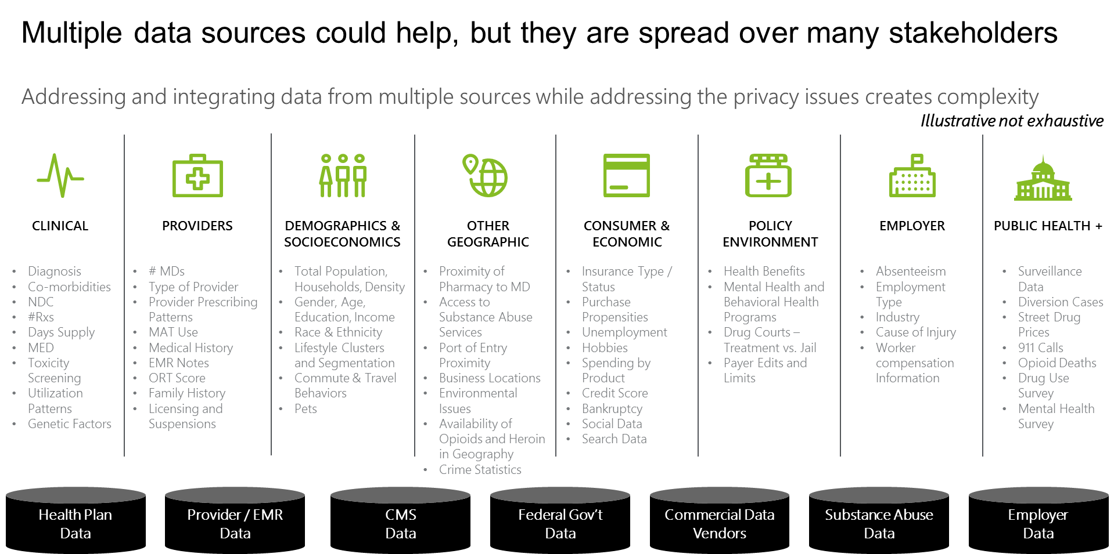
Deloitte developed several analyses, data and solution assets for life science and health care clients in response to the epidemic
Project Background
Using data and analytics, we look at a complete view of factors, from the attitudes and beliefs that form the policy environment to the treatment and access environments on which epidemiology and patient factors are based, which ultimately influence opioid related risk.
Prescription Opioid Abuse, Misuse, and Diversion / Opioid Use Disorder
Data Sources
Epidemiology + Patient Factors
Socioeconomic and patient factors How much influence patient has on treatment decisions
Access Environment
Access to drugs (via payers, plans, and “street”)
Opioid
Treatment Environment
Availability of prescribers and how they prescribe
A multi-layered problem requires aggregating data from multiple sources to be fully understood
Policy Environment
Policies around opioid use and abuse
Attitudes + Beliefs
“Criminals vs. disease” attitudes/beliefs

Slide 5
Sample Opioid Related Projects
Project Background
Below are two sample projects where the Deloitte teams have used data to tackle the opioid epidemic. Using the findings of projects like these, we engage the key stakeholders to help them understand the crisis at hand, and advise them to create targeted strategies to address their challenges.
Communities Needing Treatment Analysis
Local Market Analysis
Key Approach: composite risk index
Business Issue: Since communities exhibit a group level pattern when it comes to the impact of the opioid epidemic, the client wanted to identify the communities with highest unmet OUD (opioid use disorder) treatment needs.
Project Summary: Deloitte curated 20+ publicly available data sets and developed six different clusters of communities with different unmet treatment needs, and identified drivers and pathways that can inform various client functions to best help patients.
Key Approach: market archetype segmentation
Business Problem: The client wanted to have a deeper understanding of the opioid crisis and the key drivers of different local markets in order to develop strategies for different market needs.
Project Summary: Deloitte performed a series of local market analyses and segmentation to answer key questions about the opioid crisis and identify high-incidence priority areas for the client.

Slide 6
Project Goals and Expectations
Practicum Expectations
Part I
Part II (Optional)
Exploratory Data Analysis
Apply algorithmic techniques to identify clusters that share similar attributes
Develop descriptive and predictive profiles of market segments
Provide recommendations and suggest courses of actions to be taken based on the outcome of your analysis
Gather additional data (state agencies are a great source) and conduct an in-depth analysis of 1-2 geographical regions
Further suggest additional steps that the region could implement to tackle the epidemic
Guiding Questions
Which socio-economic, demographic, educational, environmental, political factors define a cluster and its risk profile?
Which risk factors are driving opioid usage?
What factors are mitigating factors (e.g. is access to treatment clinics significant)?
Are there anomalies in local communities and what are possible driving factors for the outliers?
What are the effects of confounding factors?
How do abuse, misuse, and diversion likelihoods differ for sub-populations?
How can health services and intervention programs be optimally located?
Do state policies have an effect on outcomes (e.g. Medicaid expansion)?
Key Deliverables
1
2
3
A file containing well-documented source code of the analyses and modeling
A written report explaining model findings, results, and recommendations
An interactive dashboard to help visualize results, built using a tool like Tableau, Shiny, Bokeh

Slide 7
Important Dates and Suggested Timeline
Logistics
Milestone | Date | Details
Kick-off Meeting | 10/02/2019 | Introduce practicum prompt and provide context of the problem
Data Transfer Complete | x | Teams should have downloaded all the data provided so that analysis, modeling, and visualization can begin
Check-in with Deloitte Team | x | Answer initial questions from students Ensure proper understanding of the problem
Exploratory Data Analysis Complete | x | Teams should use this time to understand the data and develop hypotheses Students should explore the data visually and statistically, and determine the best way to combined the datasets provided
Midpoint Review | x | Meeting with Deloitte liaisons and SMEs to review progress at the midpoint and brainstorm analysis/modeling ideas
Modeling and Analysis Complete | x | Different hypotheses and models are tested, tuned and validated
Check-in with Deloitte Team | x | Deloitte Team provides feedback on the analysis performed and the modeling thus far
Interactive Dashboard Created | x | Fine-tuning of models/analysis based on previous feedback Interactive dashboard created to showcase final results
Final Paper Drafts | x | Describe process and analysis results, also give explanation for courses of action taken and insights uncovered
Final Presentation | x | Final presentation to a panel of Deloitte Liaisons and SMEs Feedback given for the finished analyses
*Bold indicates meeting with Deloitte Liaisons

Slide 8
Questions?
Questions

Slide 9
Data Sources

Slide 10
Category | Data File Name | Source | Source Website | Years Covered | Granularity | Description
CMS | Medicare Part D Opioid Prescribing Data | CMS - Medicare Provider Utilization and Payment Data - Medicare Part D Opioid Drug Mapping Tool | https://www.cms.gov/Research-Statistics-Data-and-Systems/Statistics-Trends-and-Reports/Medicare-Provider-Charge-Data/OpioidMap.html | 2013-2015 | State, County, Zip5 | Shows geographic comparisons of de-identified Medicare part D Opioid prescription claims within the US
CMS | Opioid Drug List | CMS - Medicare Provider Utilization and Payment Data - Medicare Part D Opioid Drug Mapping Tool | https://www.cms.gov/Research-Statistics-Data-and-Systems/Statistics-Trends-and-Reports/Medicare-Provider-Charge-Data/Downloads/OpioidDrugList.zip | 2013-2015 | N/A | Provides list of drug names, generic names, and whether it's extended release.
SAMHSA | National Mental Health Services Survey (NMHSS) | Substance Abuse and Mental Health Services Administration (SAMHSA) | https://wwwdasis.samhsa.gov/dasis2/nmhss.htm | 2012, 2014, 2015, 2016 | State | The National Mental Health Services Survey (N MHSS) was conducted from September 2012 through February 2013. The N-MHSS collects information from all known facilities1in the United States, both public and private, that provide mental health treatment services to people with mental illness.
 |  |  | https://wwwdasis.samhsa.gov/dasis2/nmhss/mh2012_puf_csv.zip
NADCP | NADCP Drug Court Geospatial Data |  | https://map.nadcp.org/ |  |  | No data available for download…
Kaiser | Health Insurance Coverage Trends | Kaiser Family Foundation Data | https://www.kff.org/other/state-indicator/total-population/?activeTab=graph&currentTimeframe=0&startTimeframe=3&selectedDistributions=employer--non-group--medicaid--medicare--other-public--uninsured--total&sortModel=%7B%22colId%22:%22Location%22,%22sort%22:%22asc%22%7D | 2013-2016 | State | Insurance coverage data
RWJF | County Health Ranking | Robert Wood Johnson Foundation (RWJF) | http://www.countyhealthrankings.org/explore-health-rankings/rankings-data | 2010-2018 | County | insurance, demographics, perceptions about addiction treatment

Slide 11
Category | Data File Name | Source | Source Website | Years Covered | Granularity | Description
SAMHSA | Treatment Episode Data Sets (TEDS) | Substance Abuse and Mental Health Services Administration (SAMHSA) | https://wwwdasis.samhsa.gov/dasis2/teds.htm | 2010-2015 (Admissions) and 2006-2014 (Discharge) | State | Admissions: DS5_10_15_TEDSA_PUF_CSV.zip, Discharges: teds_d_2006_2014_csv.zip
 |  |  | https://wwwdasis.samhsa.gov/dasis2/teds_pubs/TEDS/Admissions/DS5-2010-2015/DS5_10_15_TEDSA_PUF_CSV.zip
SAMHSA | National Survey on Drug Use and Health (NSDUH) geographic data | Substance Abuse and Mental Health Services Administration (SAMHSA) | https://www.samhsa.gov/samhsa-data-outcomes-quality/major-data-collections/state-reports-NSDUH-2015 | 2012, 2013, 2014, 2015, 2016 | State | Covers the civilian, noninstitutionalized population of the United States (e.g., college dormitories, group homes, civilians dwelling on military installations, persons with no permanent residence such as homeless people in shelters and residents of single rooms in hotels) who were 12 years of age or older at the time of the survey.
SAMHSA | National Survey of Substance Abuse Treatment Services (N-SSATS) data | Substance Abuse and Mental Health Services Administration (SAMHSA) | https://wwwdasis.samhsa.gov/dasis2/nssats/NSSATS_2016/nssatspuf_2016_csv.zip | 2012-2015 | State | measures opioid dependence treatment provided in different settings
CDC | Provisional Drug Overdose Death Counts | Centers for Disease Control and Prevention (CDC), National Center for Health Statistics (NCHS), National Vital Statistics System (NVSS) | https://data.cdc.gov/NCHS/VSRR-Provisional-Drug-Overdose-Death-Counts/9uxk-pe5x/ | 2015-2017 | State | Counts representing the number of reported deaths due to drug overdose occurring in the 12-month periods ending in the month indicated
SAMHSA | SAMHSA National Survey on Substance Abuse Treatment Services (NSDUH) | Substance Abuse and Mental Health Services Administration (SAMHSA) | https://www.datafiles.samhsa.gov/study-series/ | 2012, 2013, 2014, 2015, 2016 | Case Level | No information about Geography except Population Density and County Type (Metro or Not)
 |  |  | https://www.datafiles.samhsa.gov/study-series/national-survey-drug-use-and-health-nsduh-nid13517

Slide 12
Category | Data File Name | Source | Source Website | Years Covered | Granularity | Description
AHRQ | Medical Expenditure Panel Survey | Agency for Healthcare Research and Quality (AHRQ) | https://meps.ahrq.gov/data_stats/data_overview.jsp | 2013-2015 | Regional (Northeast, Midwest, South, West)
AHRQ | Healthcare Cost and Utilization Project (HCUP) | Agency for Healthcare Research and Quality (AHRQ) |  | 2005-2016 | State | Opioid-Related Fast Stats
CDC | Cause of Death - Multiple Cause | HHS, CDC, National Center for Health Statistics (NCHS), National Vital Statistics System (NVSS) | https://wonder.cdc.gov/mcd-icd10.html | 2011-2015 | County, State | Mortality and population counts for all U.S. counties based on death certificates for U.S. residents. Each death certificate contains a single underlying cause of death, up to twenty additional multiple causes, and demographic data.
CDC | Cause of Death - Underlying Cause |  | https://wonder.cdc.gov/mcd-icd10.html | 2011-2015 | County, State | Mortality and population counts for all U.S. counties based on death certificates for U.S. residents. Each death certificate contains a single underlying cause of death, up to twenty additional multiple causes, and demographic data.
CMS | Medicare Provider Utilization and Payment Data – Part D Prescriber |  | https://www.cms.gov/Research-Statistics-Data-and-Systems/Statistics-Trends-and-Reports/Medicare-Provider-Charge-Data/Part-D-Prescriber.html | 2013-2015 | City | The Part D Prescriber Public Use File (PUF) provides information on prescription drugs prescribed by individual physicians and other health care providers and paid for under the Medicare Part D Prescription Drug Program.
SAMHSA | Buprenorphine Treatment Practitioner Locator [Restricted] | Substance Abuse and Mental Health Services | https://www.samhsa.gov/medication-assisted-treatment/physician-program-data/treatment-physician-locator/export?download=1&eid=38 | 2017 | Street Address | provide the location of all OTPs
 |  | Administration (SAMHSA)

Slide 13
Category | Data File Name | Source | Source Website | Years Covered | Granularity | Description
CMS | Drug Products in the Medicaid Drug Rebate Program | CMS - Medicaid Drug Rebate Program | https://data.medicaid.gov/Drug-Pricing-and-Payment/Drug-Products-in-the-Medicaid-Drug-Rebate-Program/v48d-4e3e/data | 2014-2017 |  | Provides a list of drug names like the Medicare Drug List
CMS | State Drug Utilization |  | https://www.medicaid.gov/medicaid/prescription-drugs/state-drug-utilization-data/index.html | 2013-2017 | State | States report drug utilization data for covered outpatient drugs that are paid for by state Medicaid Agencies since the start of the Medicaid Drug Rebate Program
DEA | DEA Drug Seizure Data |  | https://www.dea.gov/resource-center/stride-data.shtml |  | State | Cocaine, Heroin, Meth

